Slide 1
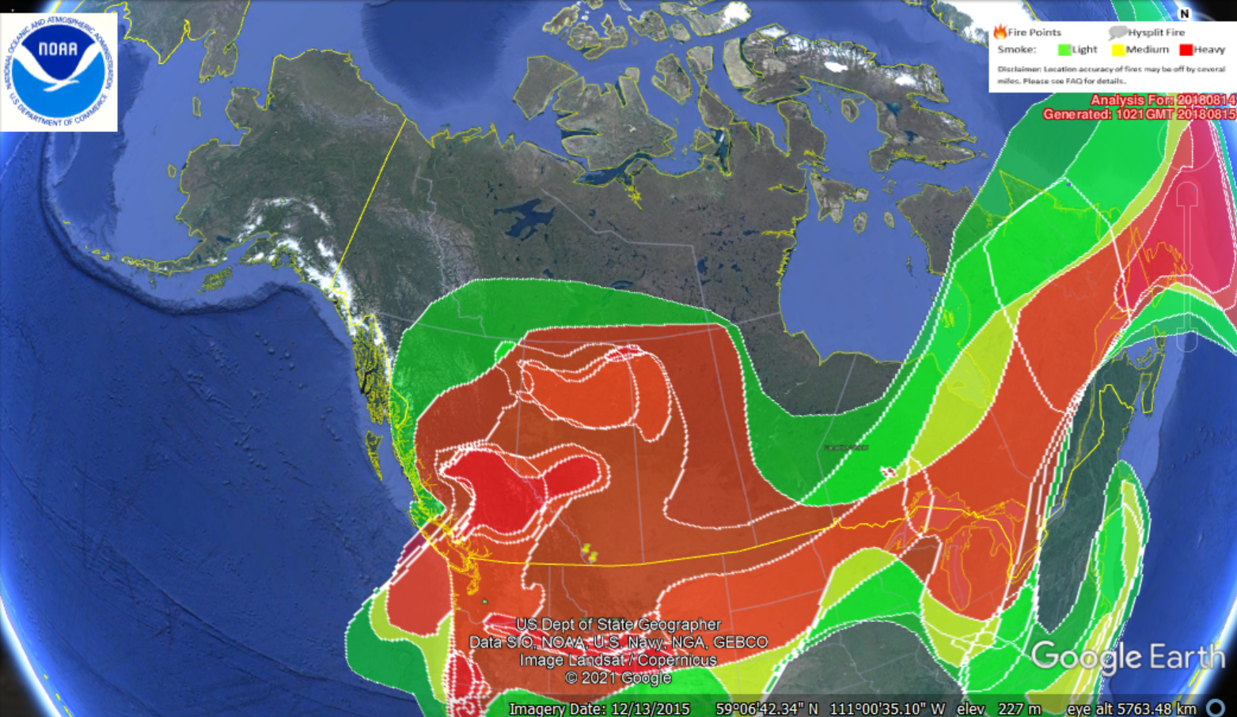
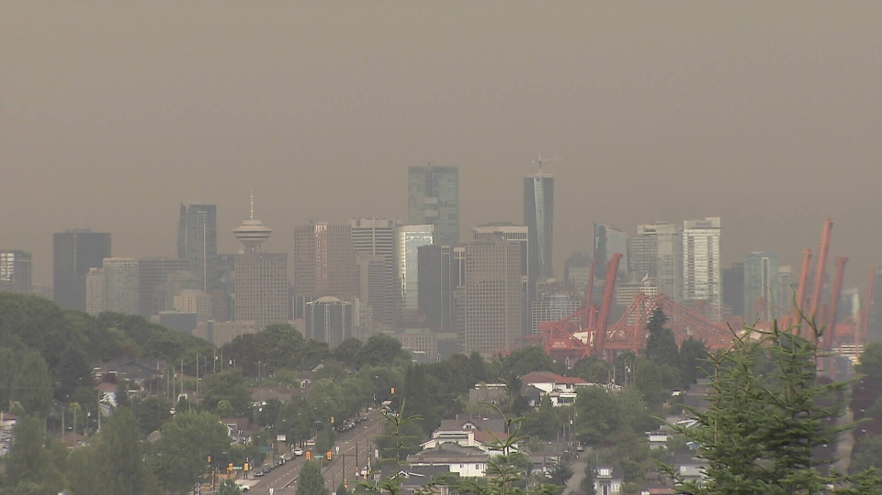
Effects of Wildfire Smoke on Forest Productivity in Central Canada
Measuring the Diffuse Radiation Fertilization Effect at AEROCAN Field Sites
Andrew Loeppky
Dr. Ian Mckendry (UBC Dept of Geography)
Images:
NOAA / wildfire hazard mapping system (top)
CTV news Vancouver 2015 (bottom)

Slide 2
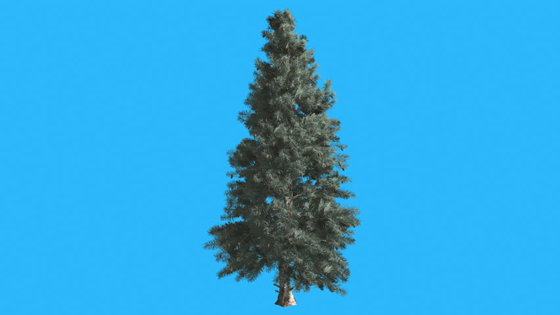
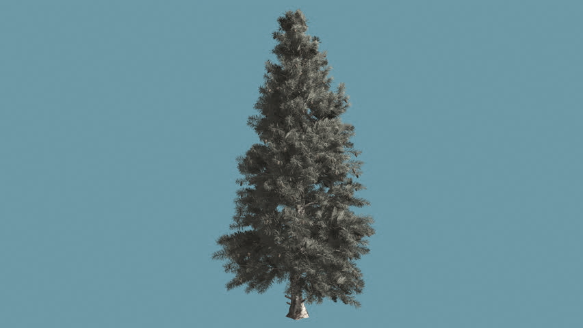

The Diffuse Radiation Fertilization Effect
Sunlight (photosynthetically active radiation, or PAR) arrives in a straight line from the sun – direct beam
Aerosols scatter light, and so it arrives at the forest canopy from many directions – diffuse PAR → more efficient CO2 uptake

Slide 3
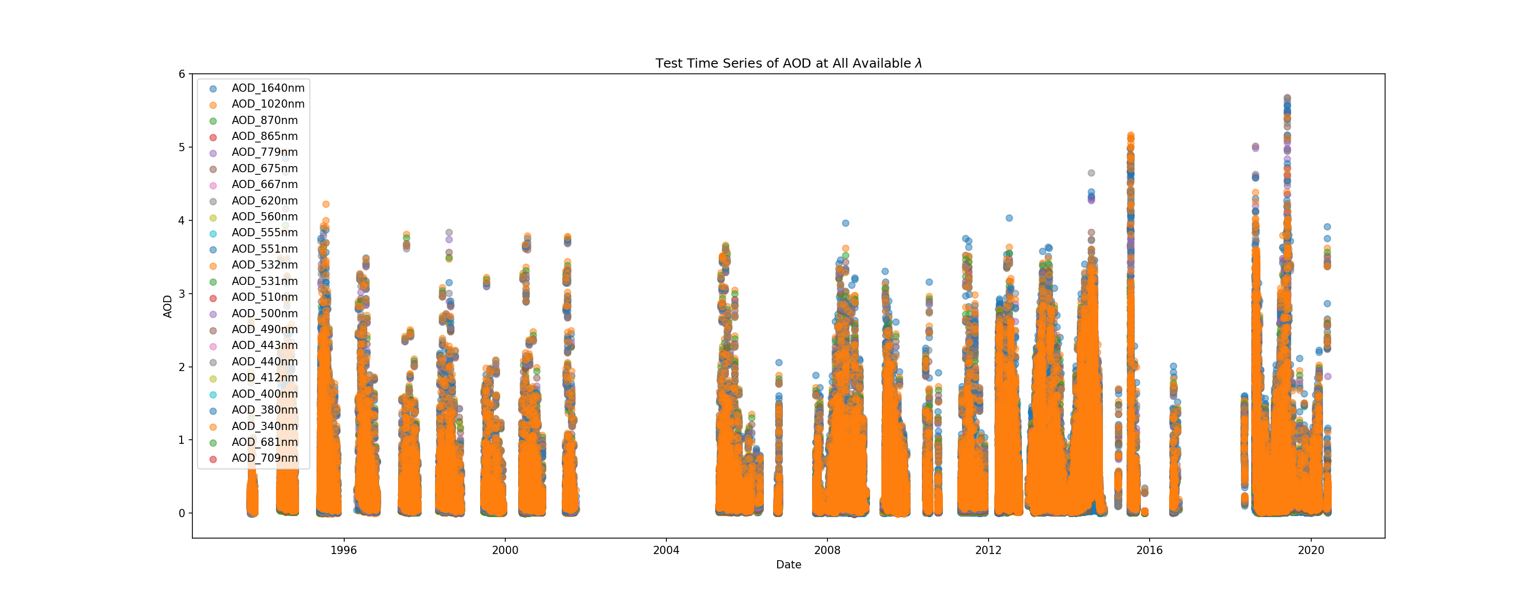
Compare satellite data, in-situ measurements of optical depth, CO2 fluxes at forest canopy in Saskatchewan – 2017, 2018
How much smoke is helpful/harmful? When do other effects outweigh DRFE? --> (Backscatter to space, Ozone, Heat stress)
Are results statistically relevant at this site? Other important variables?
(clouds, canopy structure)
Lots of diffuse PAR
Efficient Photosynthesis/CO2 uptake
Mostly direct beam
More harm than good
CO2 Uptake at Field Site
Aerosol Loading

